Slide 1
Basic Statistics
NC S&T Parenterals
17 May 2018

Slide 2
Introduction
  Statistics is widely used throughout AbbVie in S&T, R&D, Engineering, Manufacturing, Quality Assurance and other areas. This course discusses commonly used statistical methods, including:
    Process Capability
    Non-parametric statistics
    SPC concepts
  The focus will be on concepts and using software (Minitab) to perform the calculations
  Prerequisites: Basic mathematics and algebra
Basic Statistics, NCS&T Parenterals, Day 2

Slide 3
UNIT 7: Process Capability
Notes:
Course Title | Course Code and Version # | Company Confidential © 2012

Slide 4
Process Capability - Definitions
The ability of a process to produce products or provide services capable of meeting the specifications set by the customer or manufacturer.
A measure of how “capable” the process is to meet customer requirements; compares control limits (“Voice of the Process or Data”) to specification limits (“Voice of the Customer”)
    Control limits: Predict the variation that the process is expected to exhibit in the future. They reflect the common variation relative to specifications.
    Specification limits: Communicate what the customers expect, want, or need from the process.
Processes have variability – SPC seeks to identify that variability, and proceed to reduce and in some ways “control” the variability
  Once the above is accomplished, comparison is then made to the “design specifications”
  Recall, the process drives SPC whereas specifications are by intent or design
Basic Statistics, NCS&T Parenterals, Day 2

Slide 5
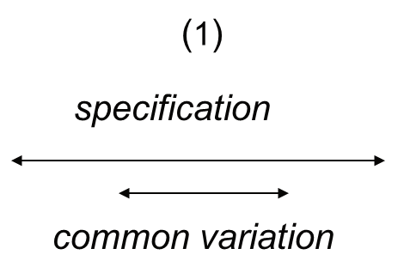
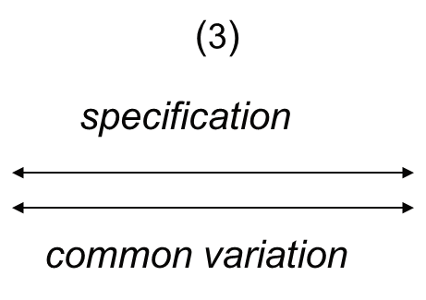
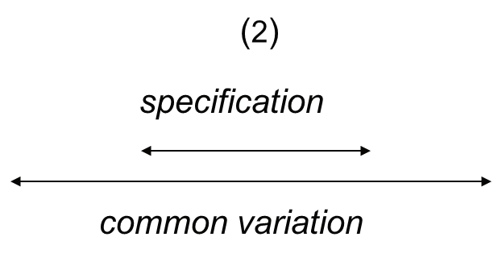
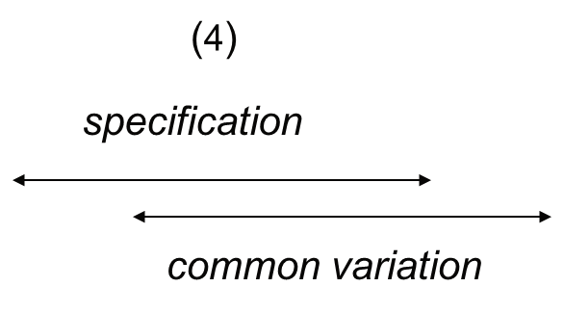
Process Capability Study: Possible Courses of Action
Adjust to reduce process variation (3): Natural tolerance range at/outside of specification range, product not meeting limits, investigate/identify root causes of variation and resolve process issues.
No adjustment (1): Natural tolerance range well within control and specification range.
Adjust process center target (4): Natural tolerance and specification ranges similar, process centering adjustment required to produce majority of product within specification limits.
Adjust specification limits (2): Widen specification range beyond natural tolerance range, as specification limits are too tight and require adjustment (tough sell to regulatory authorities).
Basic Statistics, NCS&T Parenterals, Day 2

Slide 6
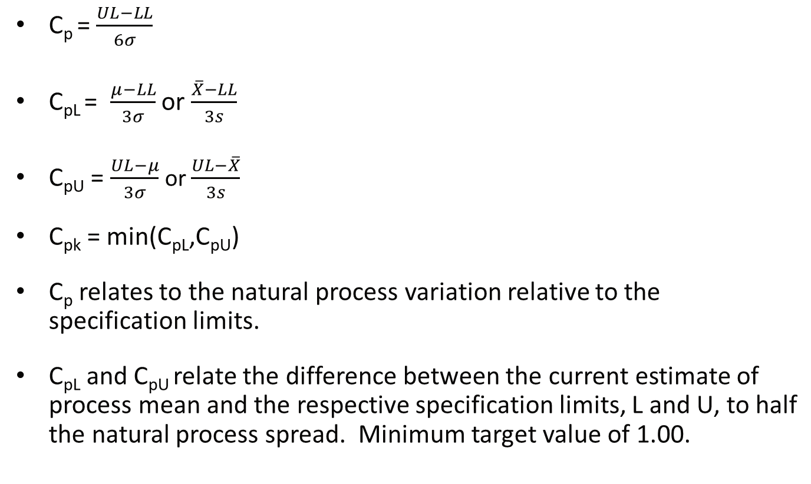
Process Capability and Performance Indexes
Basic Statistics, NCS&T Parenterals, Day 2

Slide 7
Process Capability – Interpreting Indices
Cp ≥ 1.00: The manufacturing process is capable.
Cp does not reflect process centering.
Cp < 1.00: The manufacturing process is not capable.
Cp = Cpk: The manufacturing process is centered within the specifications.
Cpk ≤ Cp: The manufacturing process is not centered within the specifications.
Cp ≥ 1.0 and Cpk ≥ 1.00: Product from the manufacturing process conforms to specifications.
Cpk < 1.00: Product from the manufacturing process does not conform to specifications.
Cpk = 0: Process average = Upper or lower specification limit.
Cpk < 0: Process average > upper specification limit or < lower specification limit.
Basic Statistics, NCS&T Parenterals, Day 2

Slide 8
Process Capability – Interpreting Indices
C_{p} | Capable? | Total amount outside limits | Typical actions to be taken
<1 | Not capable | ≥ 5.0% | Heavy process control, sorting, rework, etc.
1 | Capable at 3σ | 3 parts per 1,000 defective | Heavy process control, inspection
1.33 | Capable at 4σ | 64 parts per million defective | Reduced inspection, selected use of control charts
1.67 | Capable at 5σ | <1 part per million defective | Spot checking, selected use of control charts
2 | Capable at 6σ | ≈2 parts per billion | selected use of control charts
Basic Statistics, NCS&T Parenterals, Day 2

Slide 9
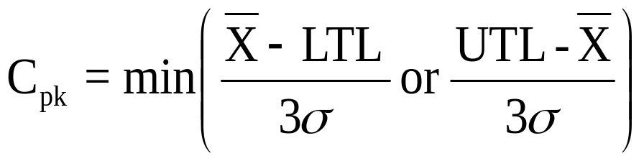
Process Capability Index, C_{pk}
A process has a mean of 45.5 and a standard deviation of 0.9. The product has a specification of 45.0 ± 3.0. Find the C_{pk} .
= min { (45.5 – 42.0)/3(0.9) or (48.0-45.5)/3(0.9) }
= min { (3.5/2.7) or (2.5/2.7) }
= min { 1.30 or 0.93 } = 0.93 (Not capable!)
However, by adjusting the mean, the process can become capable.
Basic Statistics, NCS&T Parenterals, Day 2

Slide 10
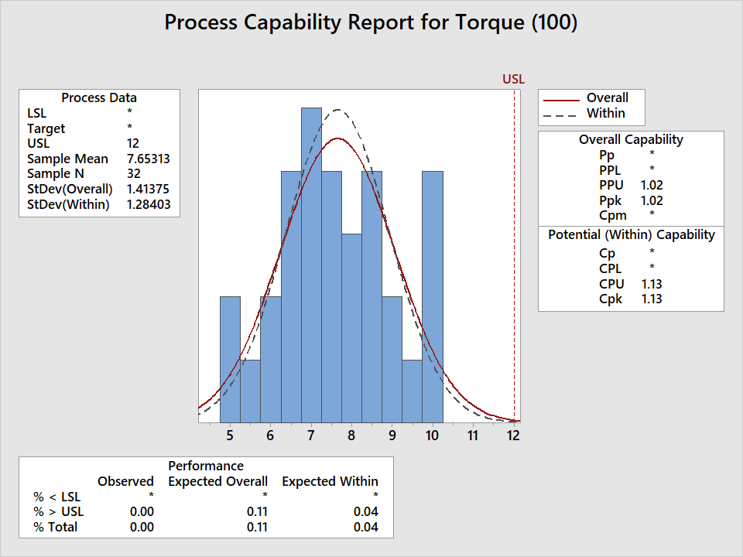
Process Capability Index - Example
R&D has collected torque results from 32 bottles and wants to determine process capability vs. a maximum value of 12 Newtons. What is the Cpk result and what is the estimate percent out of specification?
Minitab: Stat >> Quality Tools >> Capability Analysis >> Normal
Basic Statistics, NCS&T Parenterals, Day 2

Slide 11
Process Capability Index - Example
LU has collected potency results for 383 Norvir lots and wants to examine capability vs. the specification limits of 95.0% to 105.0%. Use Minitab to generate the Cp and Cpk results, to address the following questions:
Minitab: Stat >> Quality Tools >> Capability Analysis >> Normal
Is the observed process variation too wide for the specification range?
Where is the observed mean potency relative to the target of 100.0%? Is this a problem for the current process?
Does it appear any future lots are in danger of failing the specification?
Basic Statistics, NCS&T Parenterals, Day 2

Slide 12
UNIT 8: Non-Parametric Statistics
Notes:
Course Title | Course Code and Version # | Company Confidential © 2012

Slide 13
Parametric vs. Non-Parametric Test Procedures
Parametric | Non-Parametric
Involve population parameters (i.e., population mean or standard deviation) | Do not involve population parameters
Require interval (i.e., temperature) or ratio (i.e., potency, volume, length) scale data | Use with any scale of data: Ratio, Interval, Ordinal (i.e., class order, consumer ranking) or Nominal (i.e., male or female, pass or fail)
Have stringent assumptions (i.e., normal distribution, homogeneity of variance) | No stringent assumptions required for use (i.e., distribution-free)
Basic Statistics, NCS&T Parenterals, Day 2

Slide 14
Parametric vs. Non-Parametric Test Procedures
Parametric test | Non-Parametric analog
One-sample t-test or z-test | Sign test
Two sample t-test (independent samples) | Wilcoxon Rank Sum test
Two sample t-test (dependent samples) | Wilcoxon Signed Rank test
One-way Analysis of Variance | Kruskal-Wallis H-test Mann-Whitney U test
Pearson Product Moment Correlation Coefficient | Spearman Rank-Order Correlation Coefficient
Basic Statistics, NCS&T Parenterals, Day 2

Slide 15
Non-Parametric Tests: Advantages & Disadvantages
Advantages | Disadvantages
Use with any data scale | Discard usable information by converting data from higher (ratio) to lower (ordinal) scale
Easier to compute, as developed and used prior to computers | Difficult to compute by hand for large samples
Fewer assumptions required for use | Might lose distributional information (e.g., bi-modal vs. uni-modal data)
Need not involve population parameters | Critical value tables not widely available
Results may be as exact as parametric procedures
Basic Statistics, NCS&T Parenterals, Day 2

Slide 16
Non-Parametric Tests: Sign Test
Tests one population median, η (eta)
Corresponds to t-test for one mean
Assumes population is continuous
Small sample test statistic: Number of sample values above (or below) median
Can use normal approximation if n ≥ 30
Basic Statistics, NCS&T Parenterals, Day 2

Slide 17

Non-Parametric Tests: Sign Test Example
You’re an analyst for Chef-Boy-R-Dee. You’ve asked 7 people to rate a new ravioli on a 5-point Likert scale (1 = terrible to 5 = excellent). The ratings are:
2 5 3 4 1 4 5
At the .05 level of significance, is there evidence that the median rating is less than 3?
Minitab: Stat >> Nonparametrics >> 1-Sample Sign… >> Test median
Sign test of median = 3.000 versus < 3.000
N Below Equal Above P Median
Sign_Test_1 7 2 1 4 0.8906 4.000
Since the p-value > 0.05, there is no evidence the median < 3.
Basic Statistics, NCS&T Parenterals, Day 2
Notes:
Assume that the population is normally distributed.
Allow students about 10 minutes to solve this.

Slide 18
Non-Parametric Tests: Wilcoxon Rank Sum Test
Also called Mann-Whitney Test
Tests two independent population probability distributions
Corresponds to t-test for two independent means
Assumptions
  Independent, random samples
  Populations are continuous
Can use normal approximation if n_{i} ≥ 10
Basic Statistics, NCS&T Parenterals, Day 2

Slide 19


Non-Parametric Tests: Wilcoxon Rank Sum Test Example
You’re a production planner. You want to see if the operating rates for two factories is the same. For factory 1, the rates (% of capacity) are 85, 82, 94, and 97. For factory 2, the rates are 71, 82, 77, 92, and 88 . Do the factory rates have the same probability distributions at the .10 level of significance?
Mann-Whitney Test and CI: Wil_Sum_Rank_1_1, Wil_Sum_Rank_2_1
N Median
Factory 1 4 89.50
Factory 2 5 82.00
Point estimate for η1 - η2 is 7.00
93.4 Percent CI for η1 - η2 is (-6.00,19.99)
W = 25.5
Test of η1 = η2 vs η1 ≠ η2 is significant at 0.2207
The test is significant at 0.2187 (adjusted for ties)
Since the p-value > 0.10, there is no evidence the rates are different.
Basic Statistics, NCS&T Parenterals, Day 2
Notes:
51

Slide 20
Non-Parametric Tests: Wilcoxon
Signed Rank Test
Tests probability distributions of two related populations
Corresponds to t-test for dependent (paired) means
Assumptions
  Random samples
  Both populations are continuous
Can use normal approximation if n ≥ 25
Basic Statistics, NCS&T Parenterals, Day 2
Notes:
n’ is the number of non-zero difference scores.

Slide 21
Non-Parametric Tests: Signed Rank Test
Example
For the seal strength mean results previously compared from the left side of a package to the right side of 10 packages, someone has requested a comparison of the medians. Are they different at a p-value of 0.05?
© 1984-1994 T/Maker Co.
Basic Statistics, NCS&T Parenterals, Day 2

Slide 22
Non-Parametric Tests: Kruskal-Wallis Test
Tests the equality of more than two (p) population probability distributions
Corresponds to ANOVA for more than two means
Used to analyze completely randomized experimental designs
The k samples are random and independent.
There are five or more measurements in each sample.
The k probability distributions from which the samples are drawn are continuous
Uses χ² distribution with p – 1 df, if sample size n_{j} ≥ 5
Basic Statistics, NCS&T Parenterals, Day 2

Slide 23

Non-Parametric Tests: Kruskal-Wallis Test Example
To confirm the differences between the welders and their respective torque performance, management has requested a median comparison. Are the medians significantly different at a p-value of 0.01? At the 0.01 level of significance, is there a difference in the distribution of torque results?
Kruskal-Wallis Test on Torque
Welder N Median Ave Rank Z
1 8 7.250 14.9 -0.57
2 8 6.700 10.3 -2.15
3 8 9.700 25.7 3.20
4 8 7.750 15.1 -0.48
Overall 32 16.5
H = 11.57 DF = 3 P = 0.009
H = 11.58 DF = 3 P = 0.009
(adjusted for ties)
Since the p-value < 0.01, there is evidence the torque distributions are different.
Basic Statistics, NCS&T Parenterals, Day 2
Notes:
112

Slide 24
UNIT 9: Statistical Process Control
Notes:
Course Title | Course Code and Version # | Company Confidential © 2012

Slide 25
Statistical Process Control
  Typically used for quality control with long history of use within manufacturing
  Developed in 1920s at Bell Telephone Laboratories by Walter Shewart to aid in the production of telephone components that were of uniform quality
  Based on theory of process variation and examining means to identify and control it
  The key SPC tool is the control chart:
    Monitor process measures
    Identify early signs of correlation between processes and outcomes
    Identify differences across groups
    Determine time from implementation to effect
SPC combines time-series analysis with graphical representation of data
Basic Statistics, NCS&T Parenterals, Day 2

Slide 26
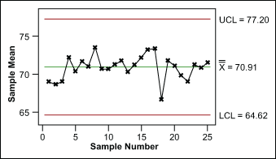
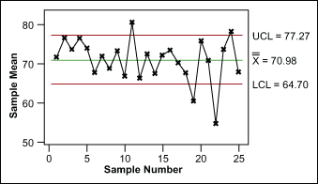
Control Charts Are a Primary Tool of SPC
Allows determination of system’s “control”
  Wide fluctuations = out-of-control systems
  Out-of-control indicates opportunity to improve reliability
Distinguishes between common- and special-cause variation
  Common-cause variation = normal,
  random variation
  Special-cause variation
    Changes in the pattern of data that can
    be assigned to a specific cause
    Cause may or may not be beneficial, intentional
Common-Cause Variation
Special-Cause Variation
Basic Statistics, NCS&T Parenterals, Day 2

Slide 27
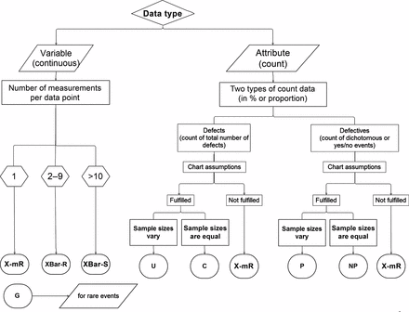
The Type of Control Chart Is Based on Your Data and Needs
Source: Radiographics. 2012 Nov-Dec;32(7):2113-26.
Basic Statistics, NCS&T Parenterals, Day 2

Slide 28
Methodology: Key Steps
Identify process(es) or outcome(s) of interest
Identify measurable attributes
Select appropriate control chart given your variable of choice
Use SPC software to generate chart type and compute mean value over time period of interest
Characterize natural variation using upper and lower control limits (± 3 SDs around mean)
Track variable to observe patterns
Determine whether changes in variable over time meet criteria indicating special cause
Basic Statistics, NCS&T Parenterals, Day 2

Slide 29
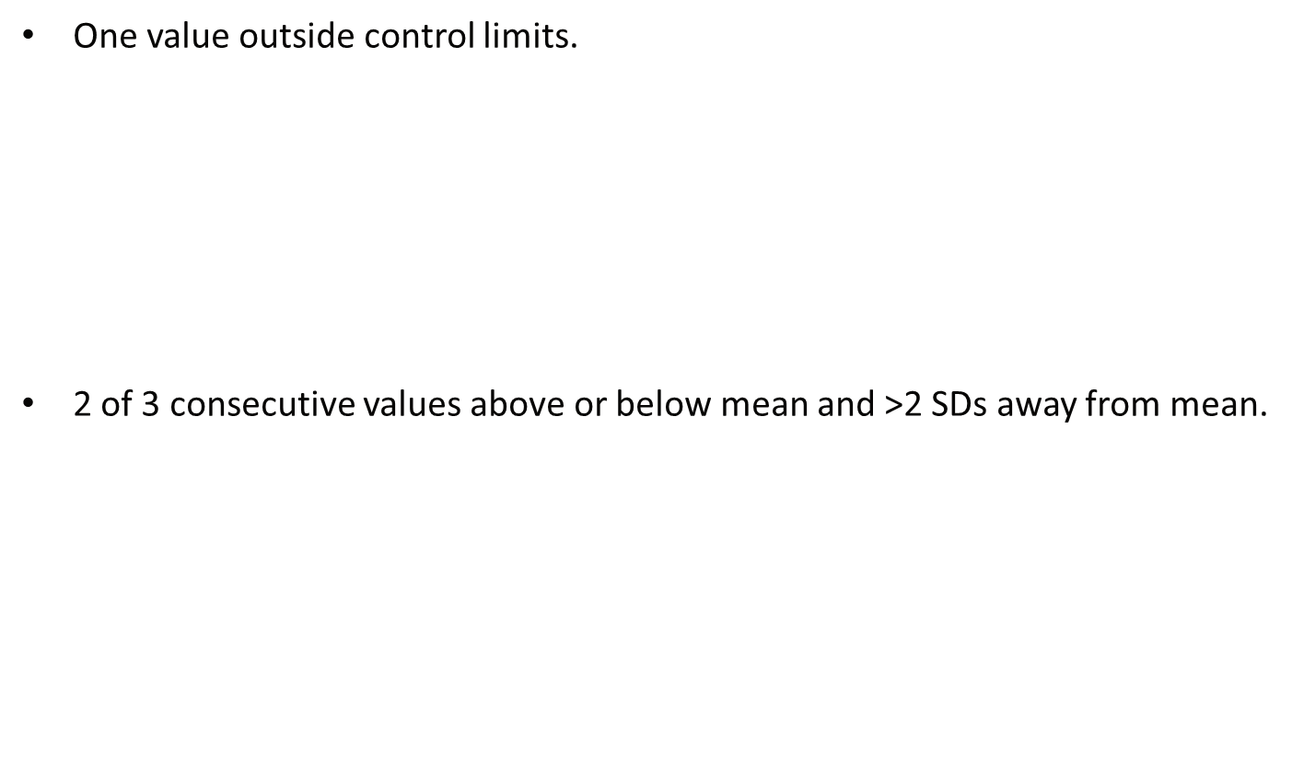
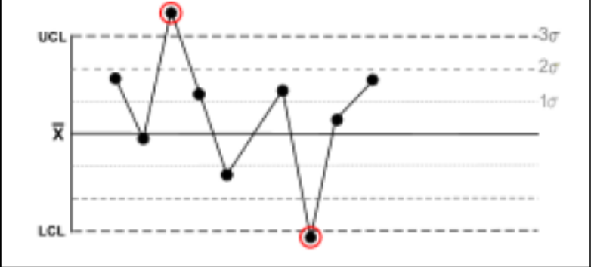
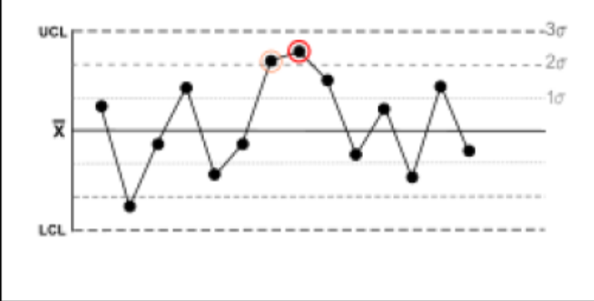
Methodology: Special-Cause Variation Criteria
Basic Statistics, NCS&T Parenterals, Day 2

Slide 30
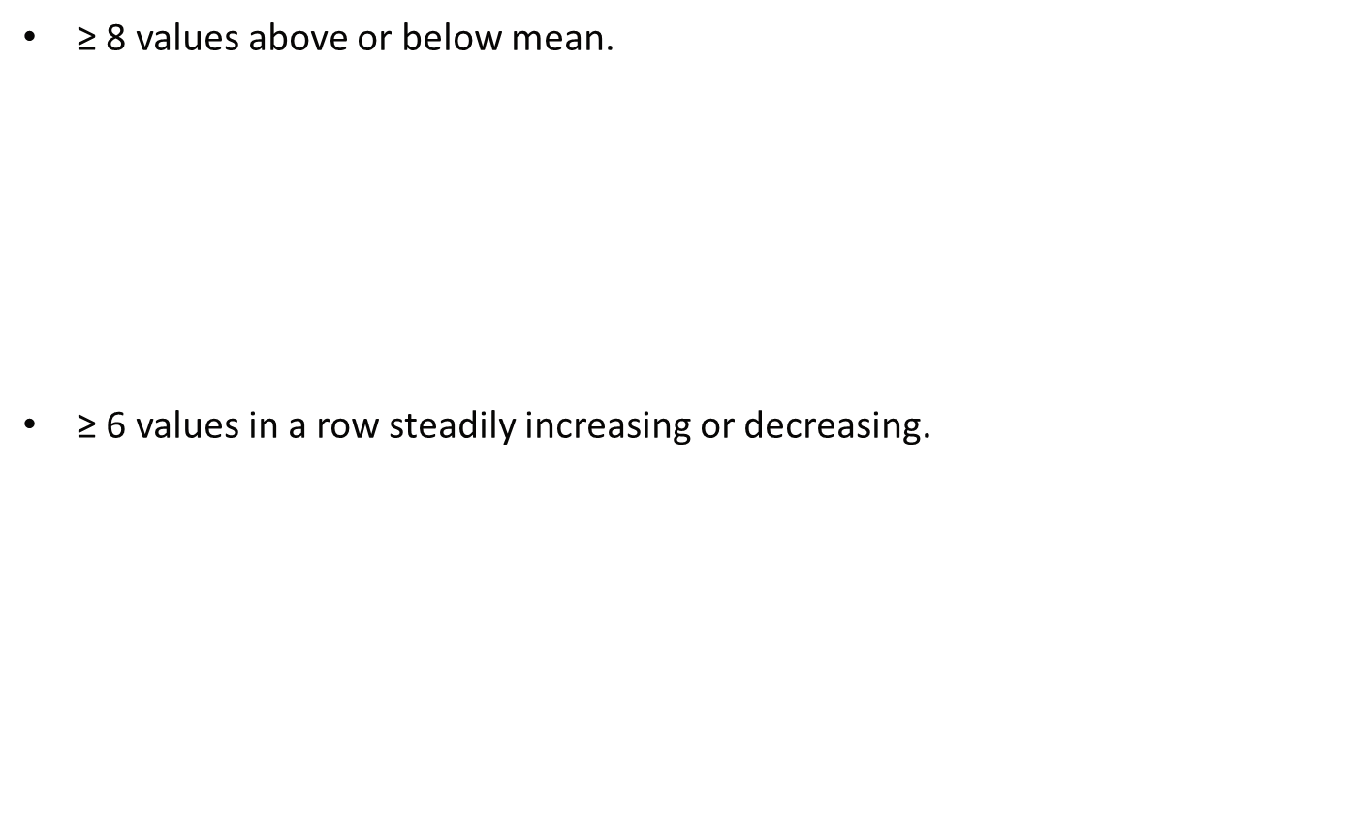
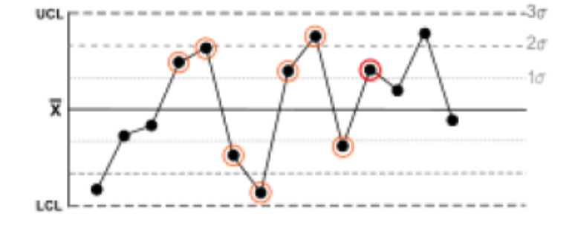
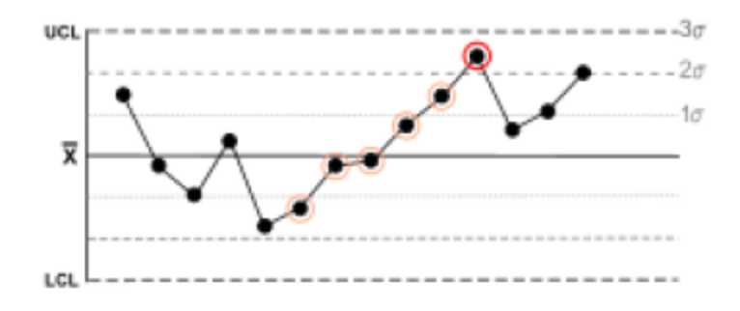
Methodology: Special-Cause Variation Criteria
Basic Statistics, NCS&T Parenterals, Day 2

Slide 31
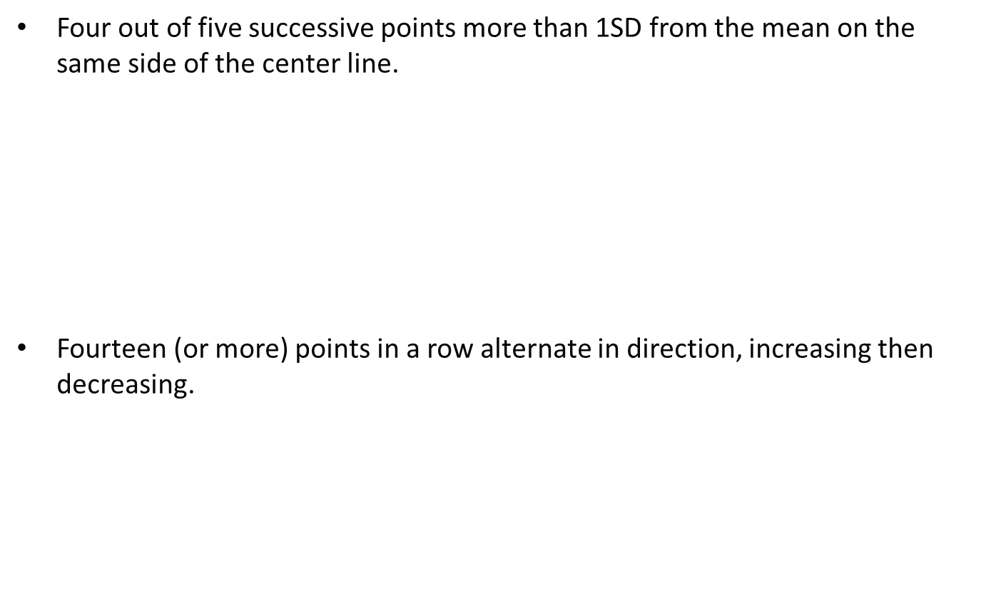
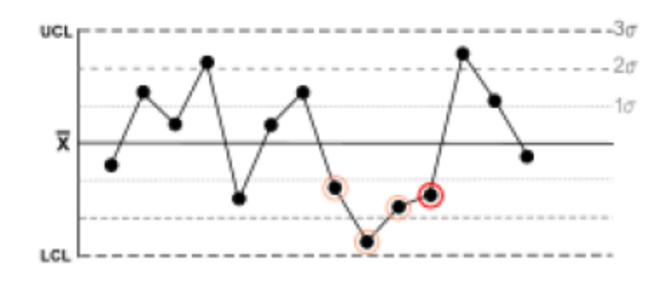
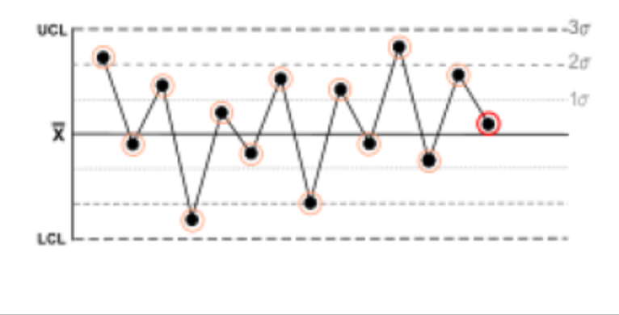
Methodology: Special-Cause Variation Criteria
Basic Statistics, NCS&T Parenterals, Day 2

Slide 32
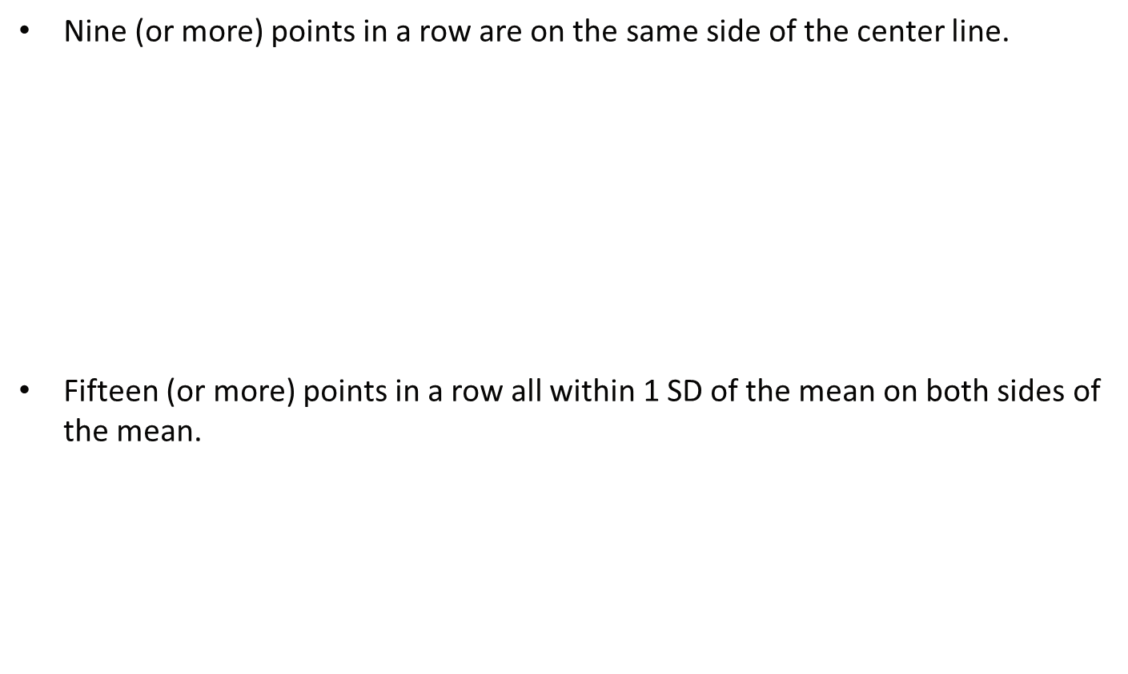
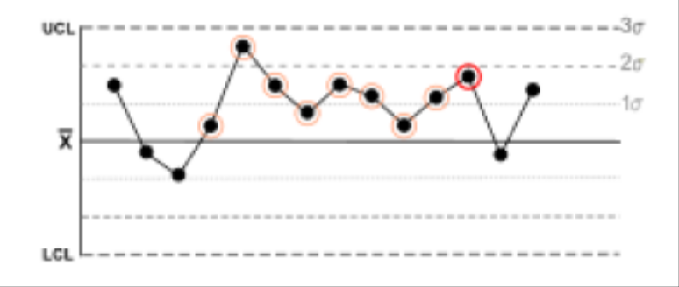
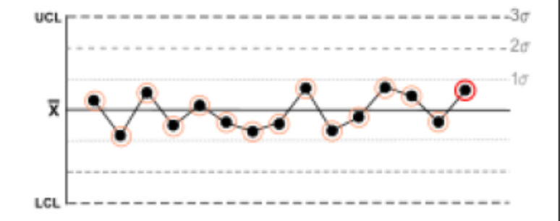
Methodology: Special-Cause Variation Criteria
Basic Statistics, NCS&T Parenterals, Day 2

Slide 33
Limitations for Using SPC
Requires frequent measurement
  Less data than traditional regression analysis (e.g., fewer sites or subjects), but control charts are only useful with data over many time periods
Involves some degree of autocorrelation
  Problem amplified with more frequent measurement
  (e.g., hourly vs. daily)
  Can reduce by using measurements 3 to 4 periods apart
Will not work in every situation
  For example, seasonal variability can impact control
  chart’s usability
  Must understand process and goals of improvement before using control charts
Requires expert consultation for initial use
Basic Statistics, NCS&T Parenterals, Day 2

Slide 34
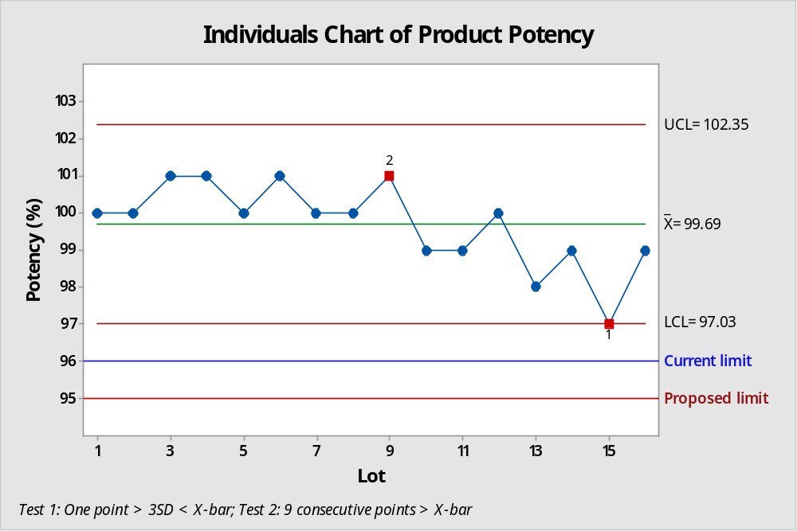

Pharmaceutical Statistics: Charting potency results vs. statistical process control limits, current and proposed limits
Use of Statistics in the Pharmaceutical Realm, ASQ, Nov 2017, p. 20
Basic Statistics, NCS&T Parenterals, Day 2

Slide 35
SPC - Individuals Chart Example
LU has collected potency results for 383 Norvir lots and wants to examine capability vs. the specification limits of 95.0% to 105.0%. Use Minitab to generate an Individuals Chart to assess the data for any evident trends.the Cp and Cpk results, to address the following questions:
Minitab: Stat >> Quality Tools >> Capability Analysis >> Normal
Are the control limits within the specification range?
Are there any limit violations identified amongst the results?
Are there any trend violations identified amongst the results?
Do the lot results display a process that is in control or out of control?
Basic Statistics, NCS&T Parenterals, Day 2

Slide 36
SPC – MR Chart Example
LU has collected potency results for 383 Norvir lots and wants to examine capability vs. the specification limits of 95.0% to 105.0%. Use Minitab to generate an MR Chart to assess the result ranges for any evident trends and address the following questions:
Minitab: Stat >> Quality Tools >> Capability Analysis >> Normal
Are the control limits within the specification range?
Are there any limit violations identified amongst the results?
Are there any trend violations identified amongst the results?
Do the MR chart results display a process that is in control or out of control?
Basic Statistics, NCS&T Parenterals, Day 2

Slide 37

Questions
Basic Statistics, NCS&T Parenterals, Day 2

Slide 38
Where to Get More Information
  Other training sessions
    JMP or Minitab training
    Green belt, Black belt, Master Black Belt training
    CQE statistics class
    College course
  Books
    Juran’s Quality Handbook
    Six Sigma books
    College course textbooks
  Online courses
    Minitab online training
    Free online training: search engine
  JMP and Minitab Help Functions
Basic Statistics, NCS&T Parenterals, Day 2

Slide 39
Statistical Tables
  Normal
  T
  Chi-square
  F: 0.05, 0.025, 0.01
  Fmax test (Hartley)
  Poisson
Basic Statistics, NCS&T Parenterals, Day 2

Slide 40
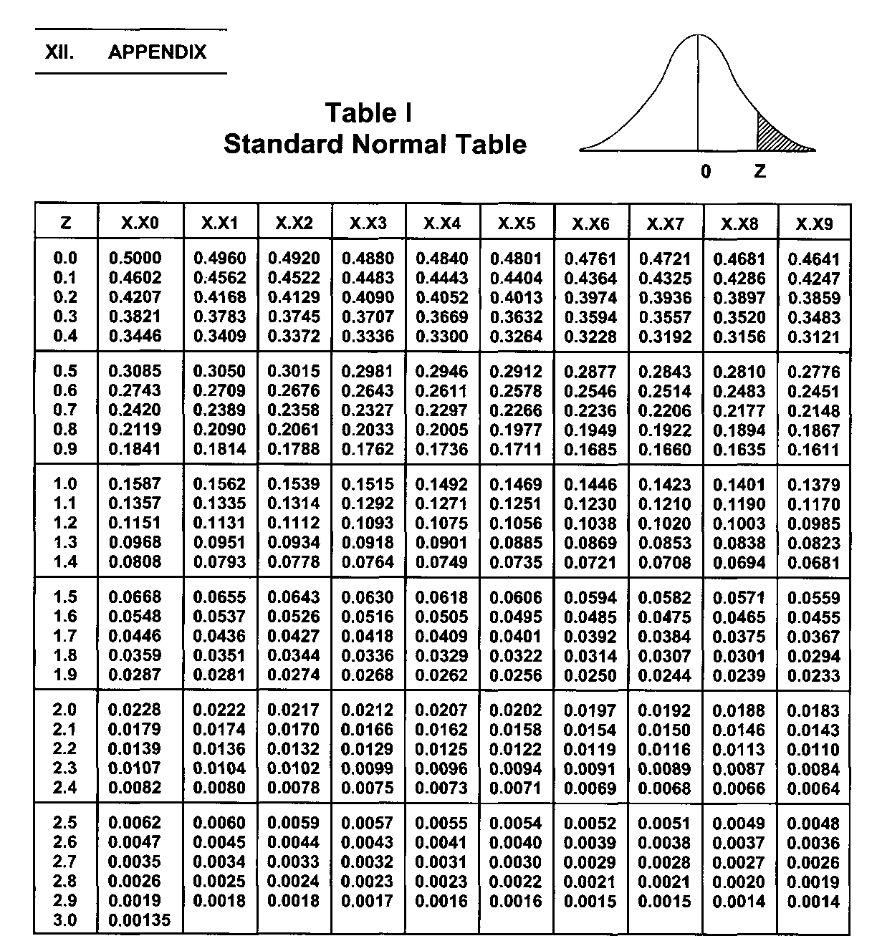
Standard Normal Distribution
Z table
Standard normal with mean=0, std dev = 1
Basic Statistics, NCS&T Parenterals, Day 2

Slide 41
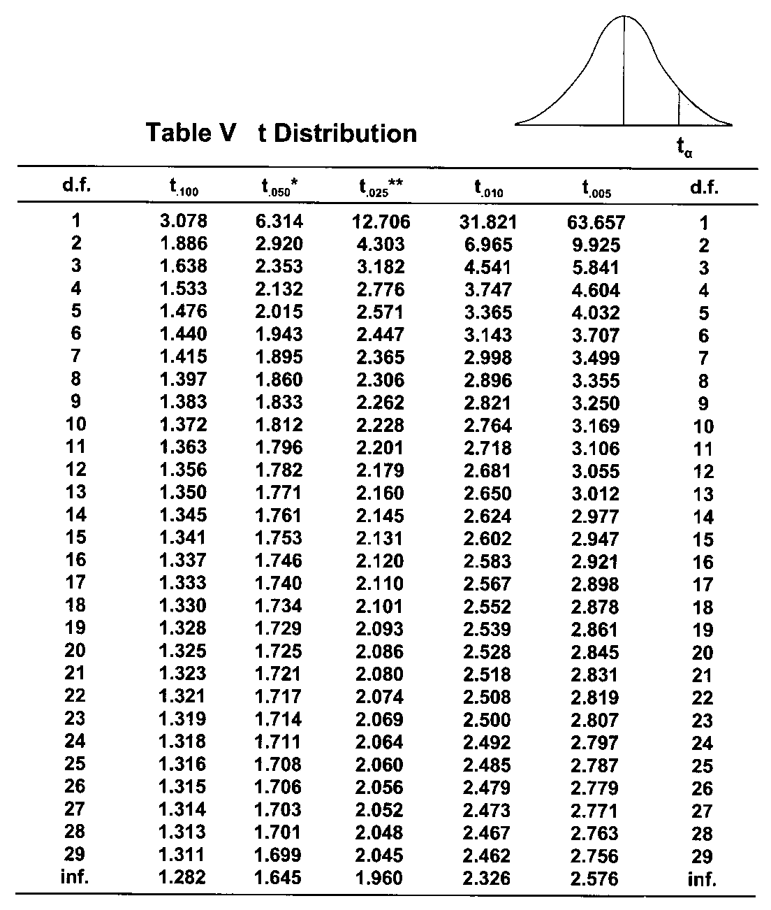
t Distribution
Basic Statistics, NCS&T Parenterals, Day 2

Slide 42
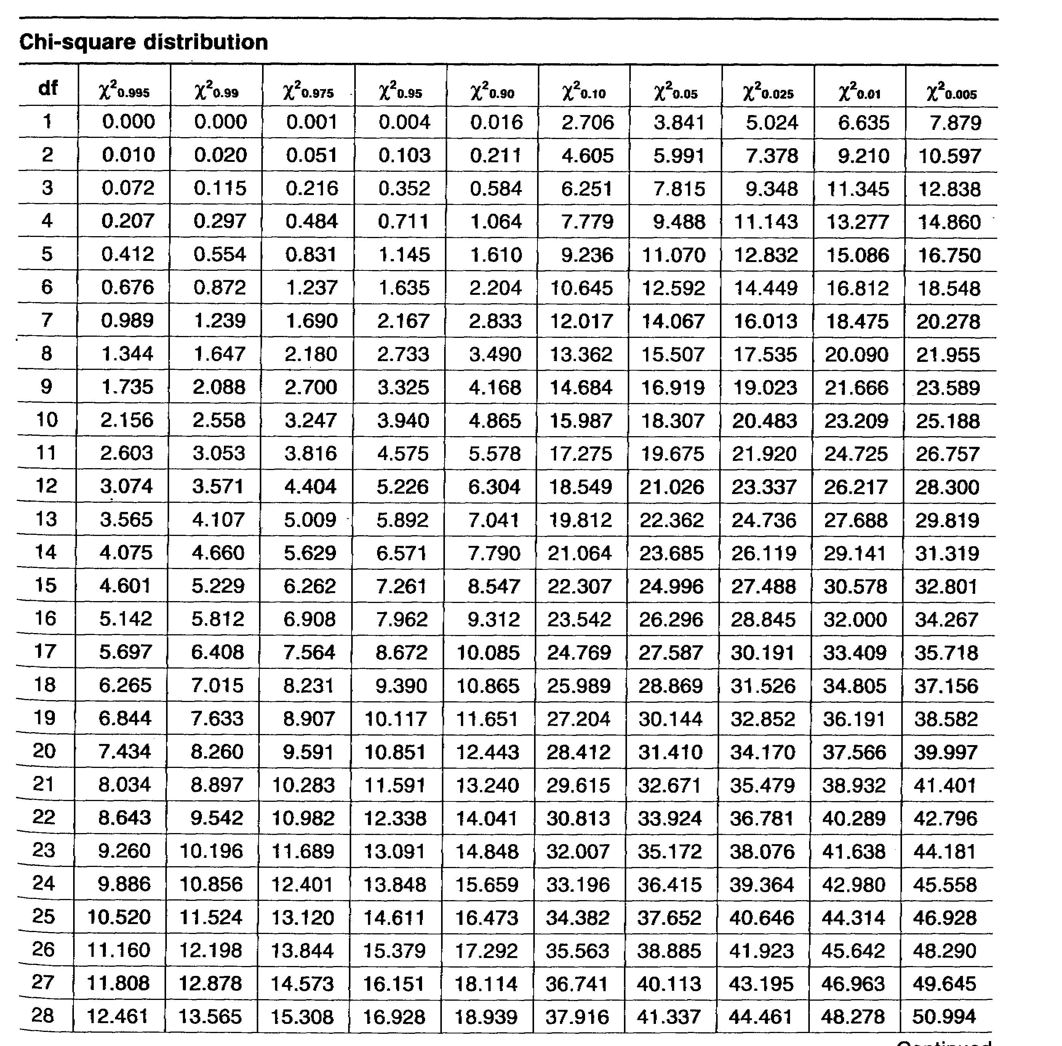
Chi-square distribution
Basic Statistics, NCS&T Parenterals, Day 2

Slide 43
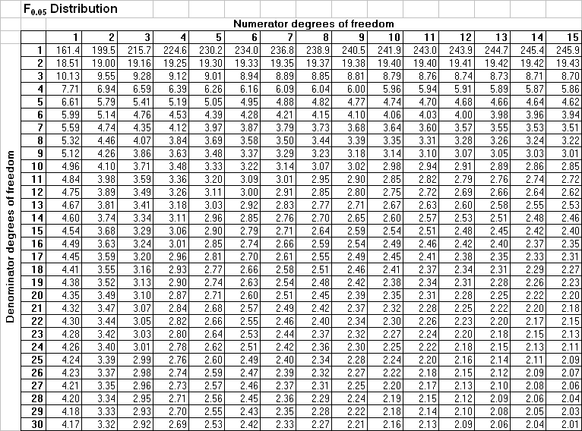
F Distribution: α=0.05
Basic Statistics, NCS&T Parenterals, Day 2

Slide 44
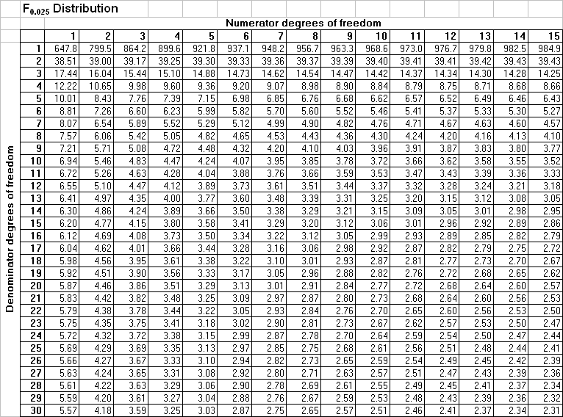
F Distribution: α=0.025
Basic Statistics, NCS&T Parenterals, Day 2

Slide 45
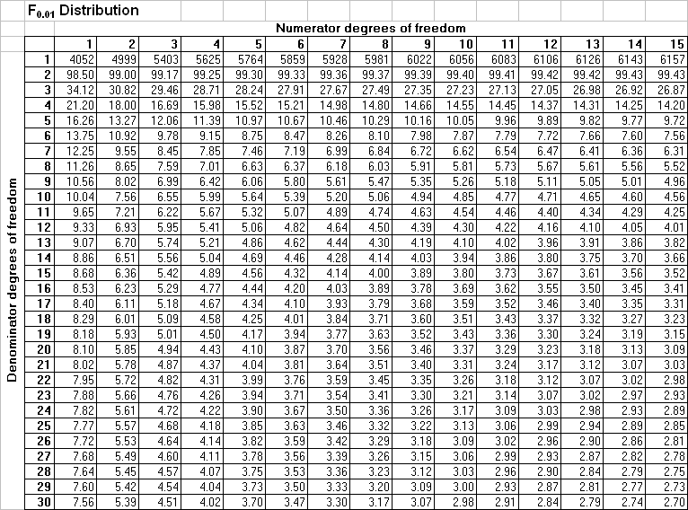
F Distribution: α=0.01
Basic Statistics, NCS&T Parenterals, Day 2

Slide 46
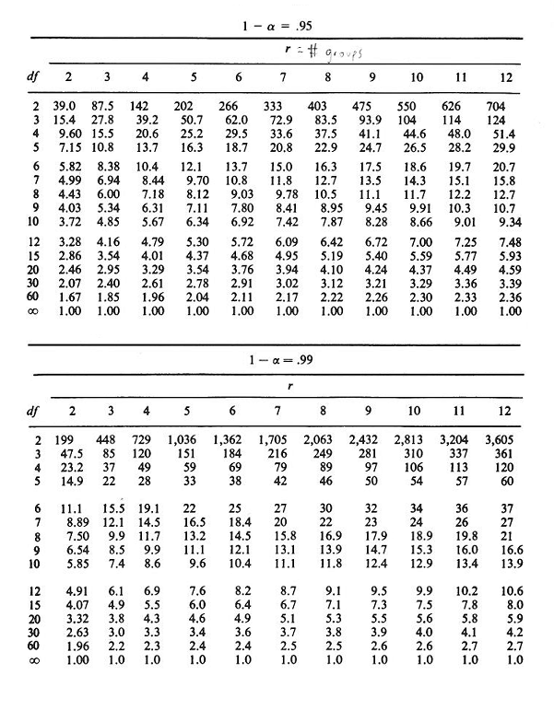
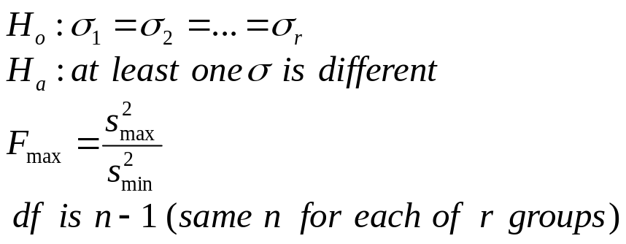
Fmax (Hartley) Test
Basic Statistics, NCS&T Parenterals, Day 2

Slide 47
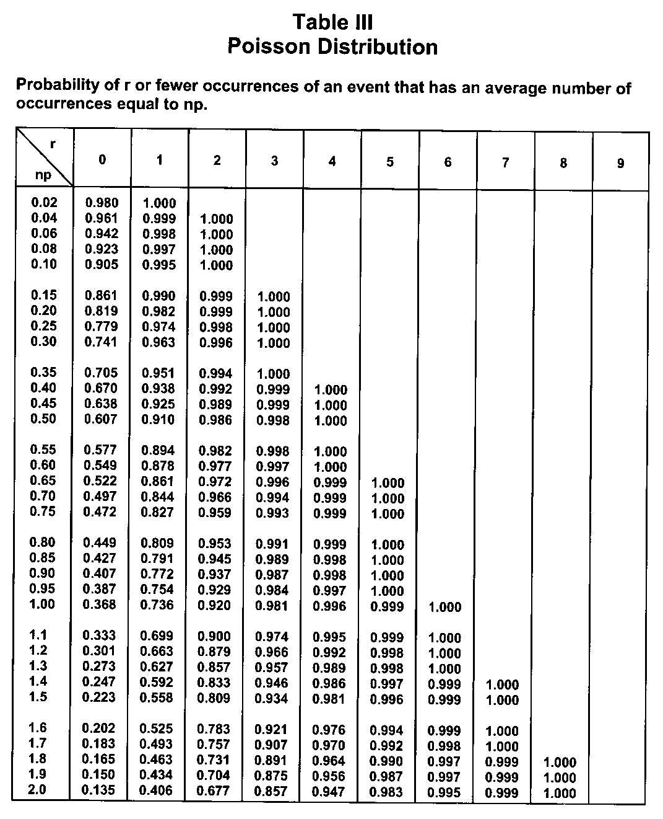
Poisson Distribution
Basic Statistics, NCS&T Parenterals, Day 2

Slide 48
Basic Statistics, NCS&T Parenterals, Day 2
Notes:
Project Plan of Separating AQR Courses to AbbVie| 01.31.13 | Company Confidential © 2012

